Slide 1

GENDER AND LABOUR

Slide 2


Topics
Division and Valuation of Labour
Housework: The Invisible Labor
“My Mother doesn’t Work.” “Share the Load.”
Work: Its Politics and Economics
Unrecognized and Unaccounted work.
Gender Development Issues
Gender, Governance and Sustainable Development
Gender and Human Rights
Gender and Mainstreaming

Slide 3

Division and Valuation of Labour
The division of labor refers to the way each society divides work among men and women, boys and girls, according to socially-established gender roles or what is considered suitable and valuable for each sex.
Valuation of labour
In jobs
In labour work
In household and Caring

Slide 4
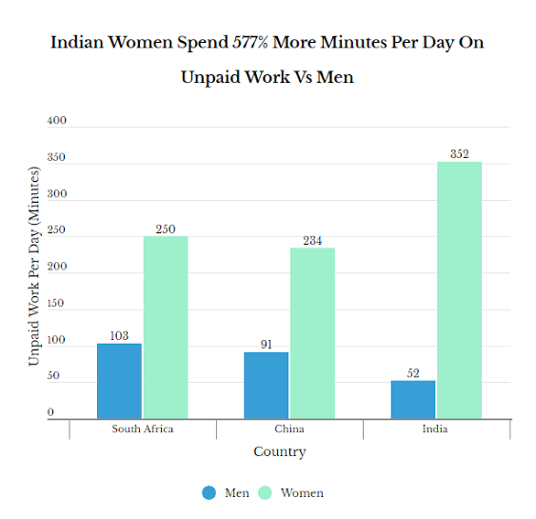

Housework: The Invisible Labor
“My Mother doesn’t Work.” “Share the Load.”
Unrecognized and Unaccounted work.

Slide 5

Work: It's Politics
Women do two-thirds of the world's work
✓receive 10% of the world's income ✓own less than 1% of land.
Women in developing countries on average carry 20 litres of water per day over 6 km
women in many cases are the primary care givers
and balancing the challenges of work and family is complex.
Global leader is still a gender pay gap.
A lack of women parliamentary
and women's health over all around the
world is worse than that of men.
They mostly do Unpaid work.

Slide 6

Gender politics is an approach to the study of politics which focuses on:
The social construction of gender- masculinity and femininity
The role of gender in political and social life.

Slide 7
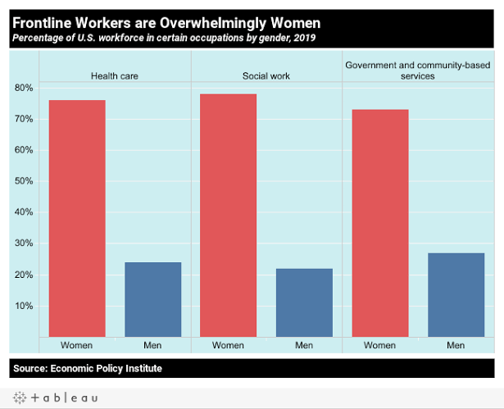

Slide 8
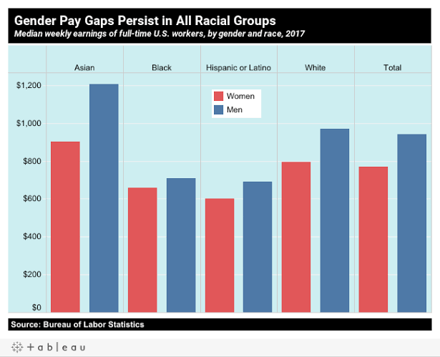

Slide 9
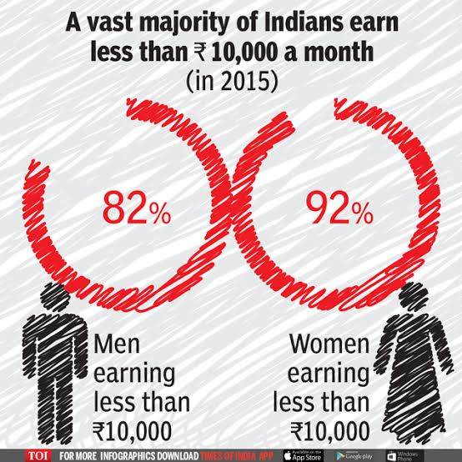
Gender: It's Economic

Slide 10
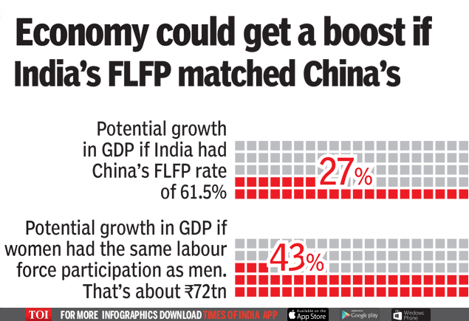
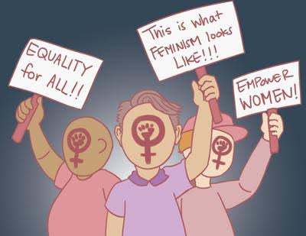

Slide 11
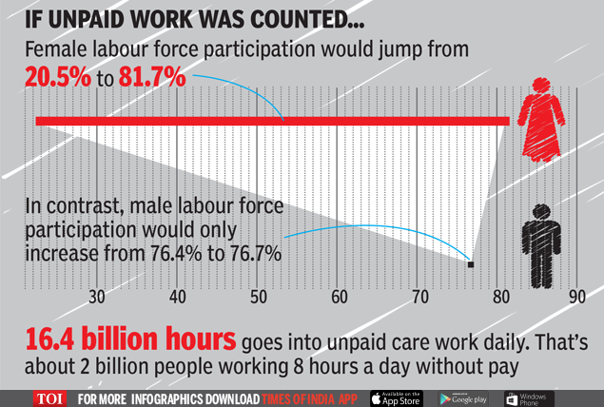

Slide 12
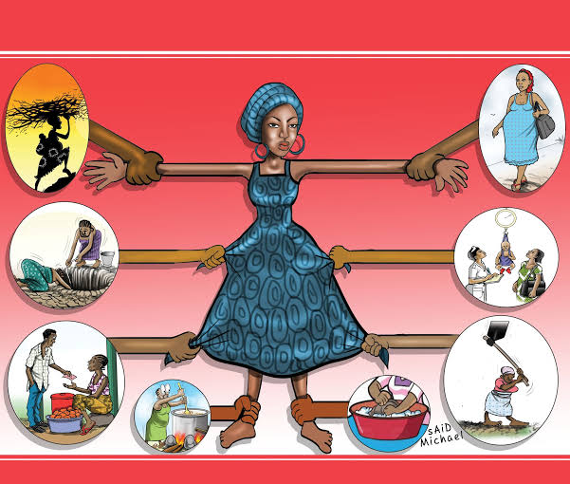
Gender Development Issues
Every 5 Minutes, A Pregnant
Woman Dies In India: WHO
A 2020 study from the World Economic Forum found "Some 220 million Indians sustained on an expenditure level of less than Rs 32 / day.
Women 2/3 in poverty. • Men 1/3 in poverty.
Almost 60% of world illiterate population is women.
Notes:
Girl child are thrown away by some people, during births.

Slide 13
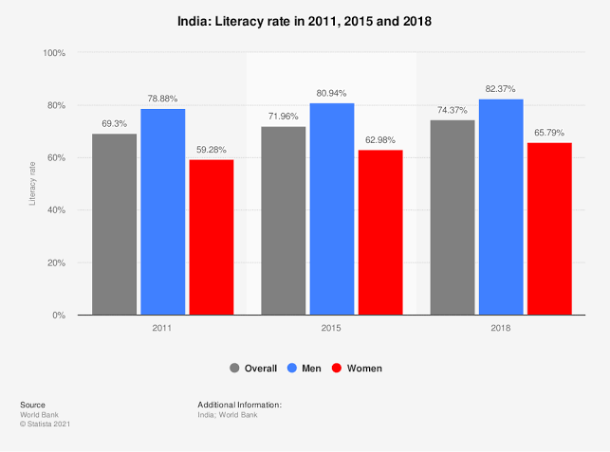
Notes:
A mortality rate is a measure of the frequency of occurrence of death in a defined population during a specified interval. The infant mortality rate is the number of infant deaths for every 1,000 live births. The child mortality rate, also under-five mortality rate, refers to the probability of dying between birth and exactly five years of age expressed per 1,000 live births.

Slide 14
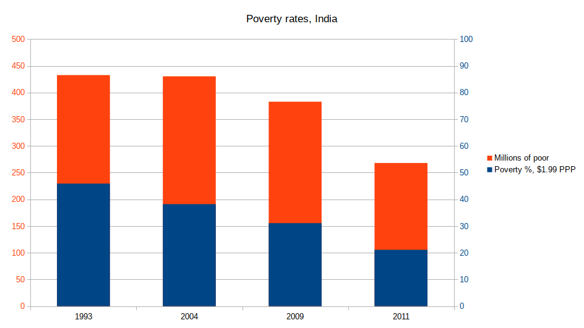

Slide 15
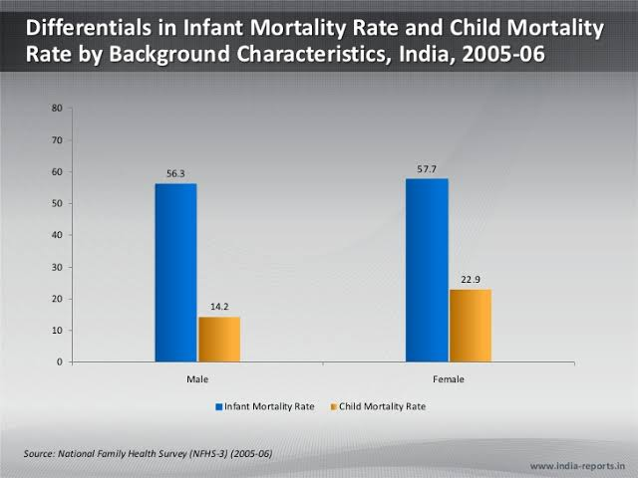

Slide 16
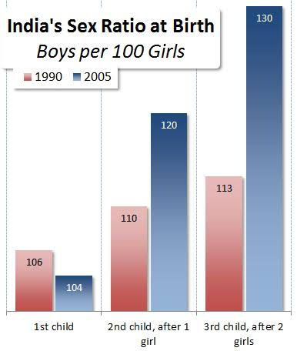

Slide 17
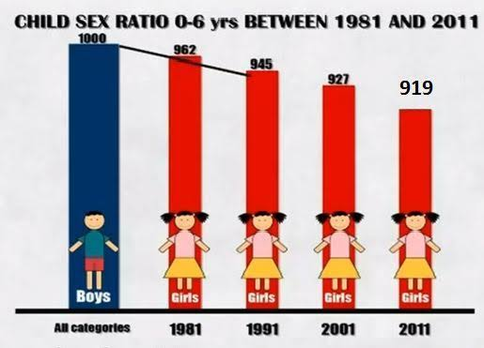

Slide 18
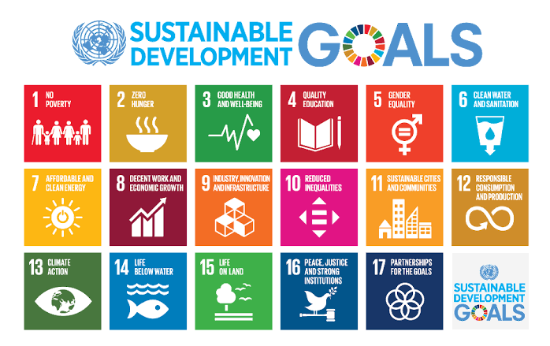
Gender, Governance and Sustainable Development
A development approach that seeks to equalize the status and condition of and relations between women and men by influencing the processes and outputs of policymaking, planning, budgeting, implementation, and monitoring and evaluation so that they would deliberately address the gender issues and concerns affecting the full development of women.
Notes:
Governance has been defined to refer to structures and processes that are designed to ensure accountability, transparency, responsiveness, rule of law, stability, equity and inclusiveness, empowerment, and broad-based participation.

Slide 19

Gender and Human Rights
Te Equal Remuneration Act 1976
The Maternity Benefits Act 1961
The Medical Termination of Pregnancy Act 1971
The Hindu Marriage Act 1955
Untouchability Act 1955
Minimum Wages Act and Child Labour Act.
The Indian Divorce Act 1969
Dowry Prohibition Act 1961
The Child Marriage Restraint Act
Criminal Law Act
The Immoral Traffic Act
The requirements of the Factories Act

Slide 20
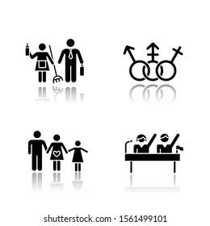
Gender and Mainstreaming
Gender mainstreaming has been embraced internationally as a strategy towards realising gender equality.
Gender mainstreaming ensures that policy-making and legislative work is of higher quality and has a greater relevance for society.
Aim to avoid the creation or reinforcement of inequalities.
Undo the mechanisms that caused inequality in society.
Notes:
It involves the integration of a gender perspective into the preparation, design, implementation, monitoring and evaluation of policies, regulatory measures and spending programmes, with a view to promoting equality between women and men, and combating discrimination.

Slide 21

🇮🇳
JAI HIND

